Slide 1
TEAM NINJA
Computer and Technology

Slide 2
Introduction to Computer
Mominul Islam, Team Ninja
1

Slide 3
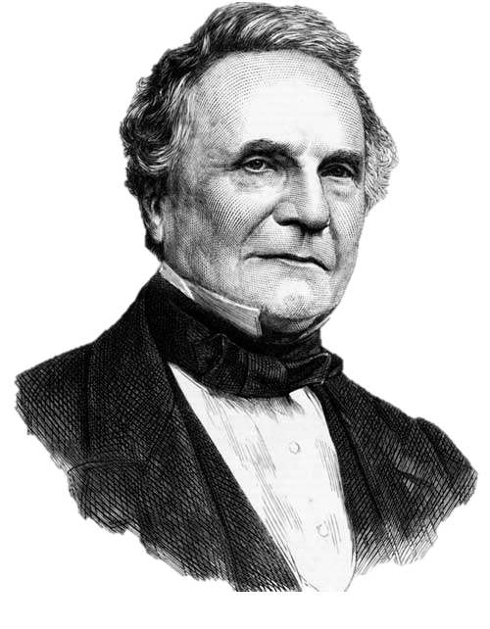
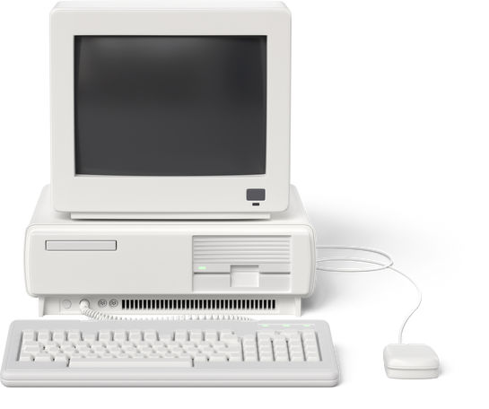
Early History of Computer
One of the earliest and most well-known devices was
an abacus.
Charles Babbage
2

Slide 4
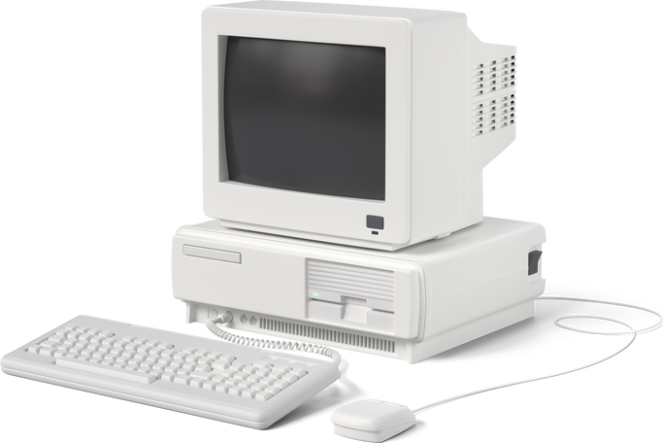
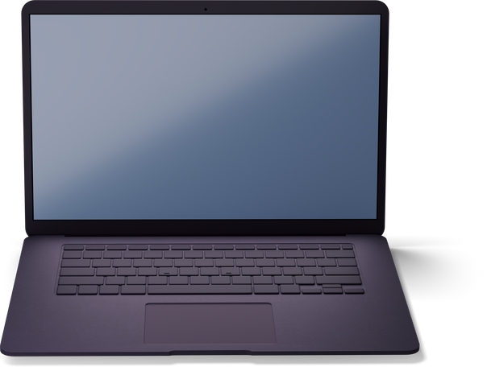
Revolution of computer
3
Source: https://icons8.com/

Slide 5
DIFFERENT TYPES OF COMPUTER AND HARDWARE
4

Slide 6
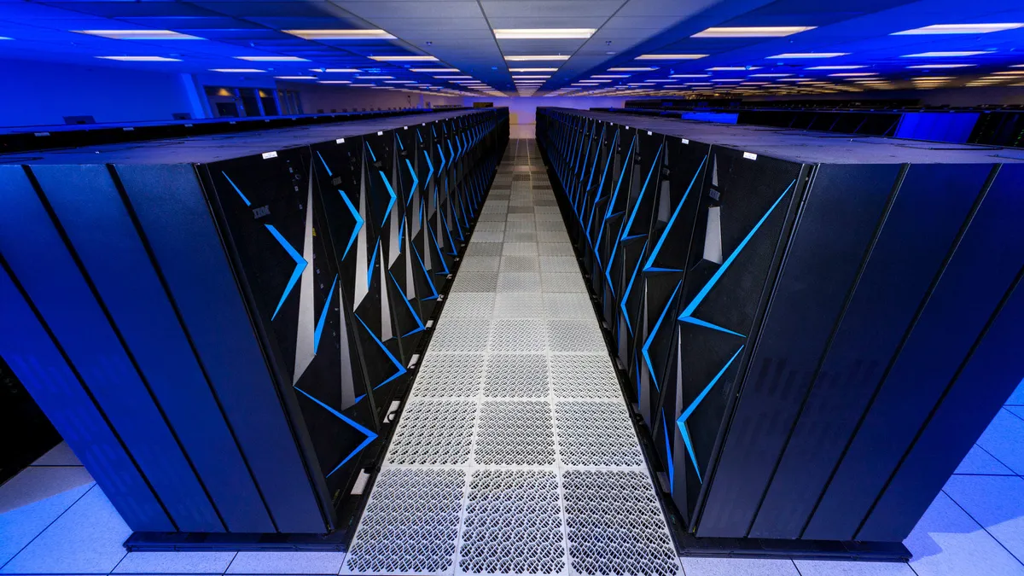

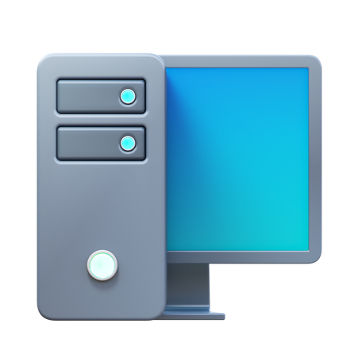
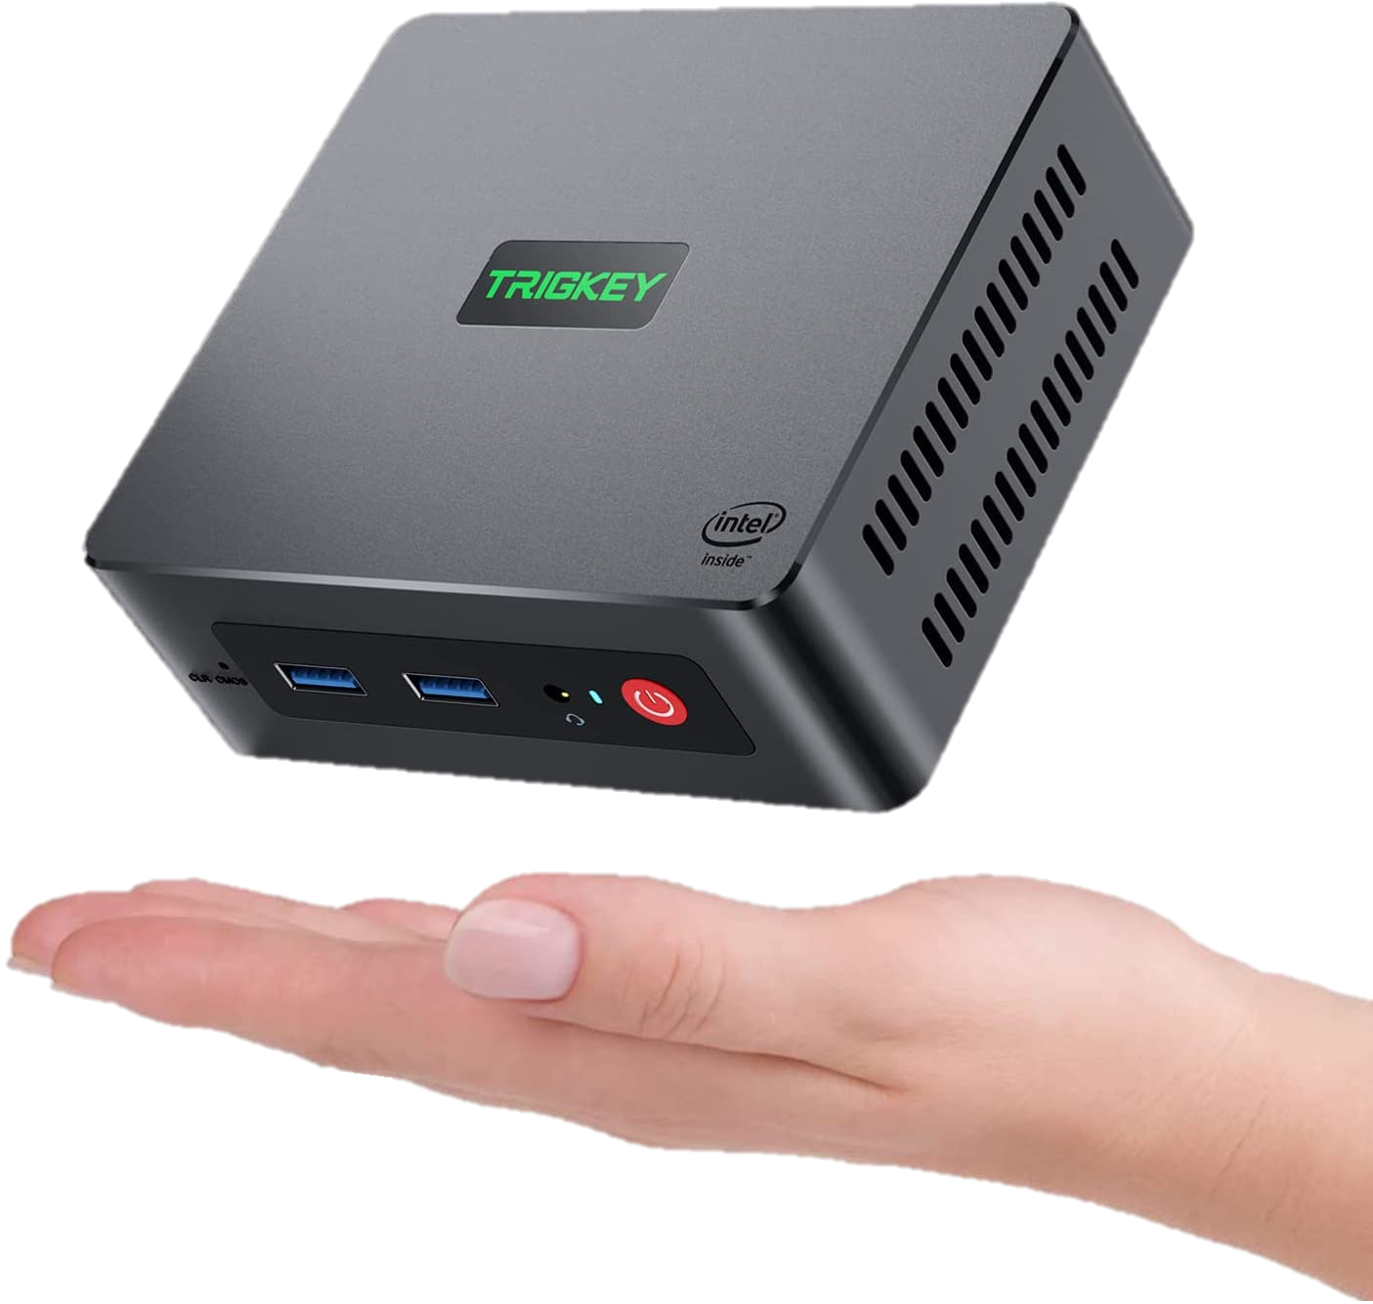
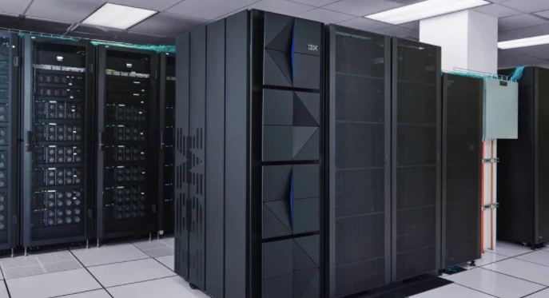
TYPES OF COMPUTER
SUPER COMPUTER
MICRO COMPUTER
MINI COMPUTER
MAINFRAME COMPUTER
5
Based on Size
Source: https://www.google.com/imghp?hl=en

Slide 7
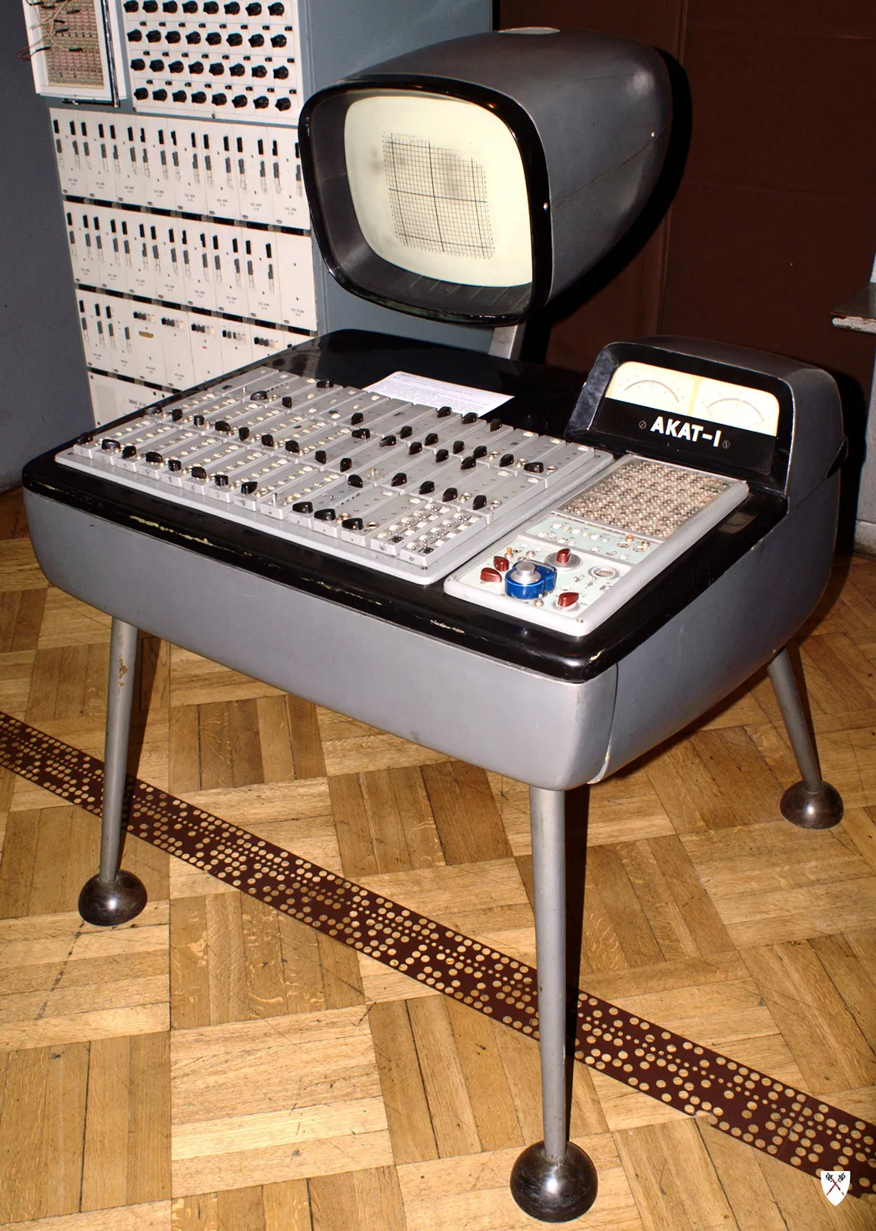
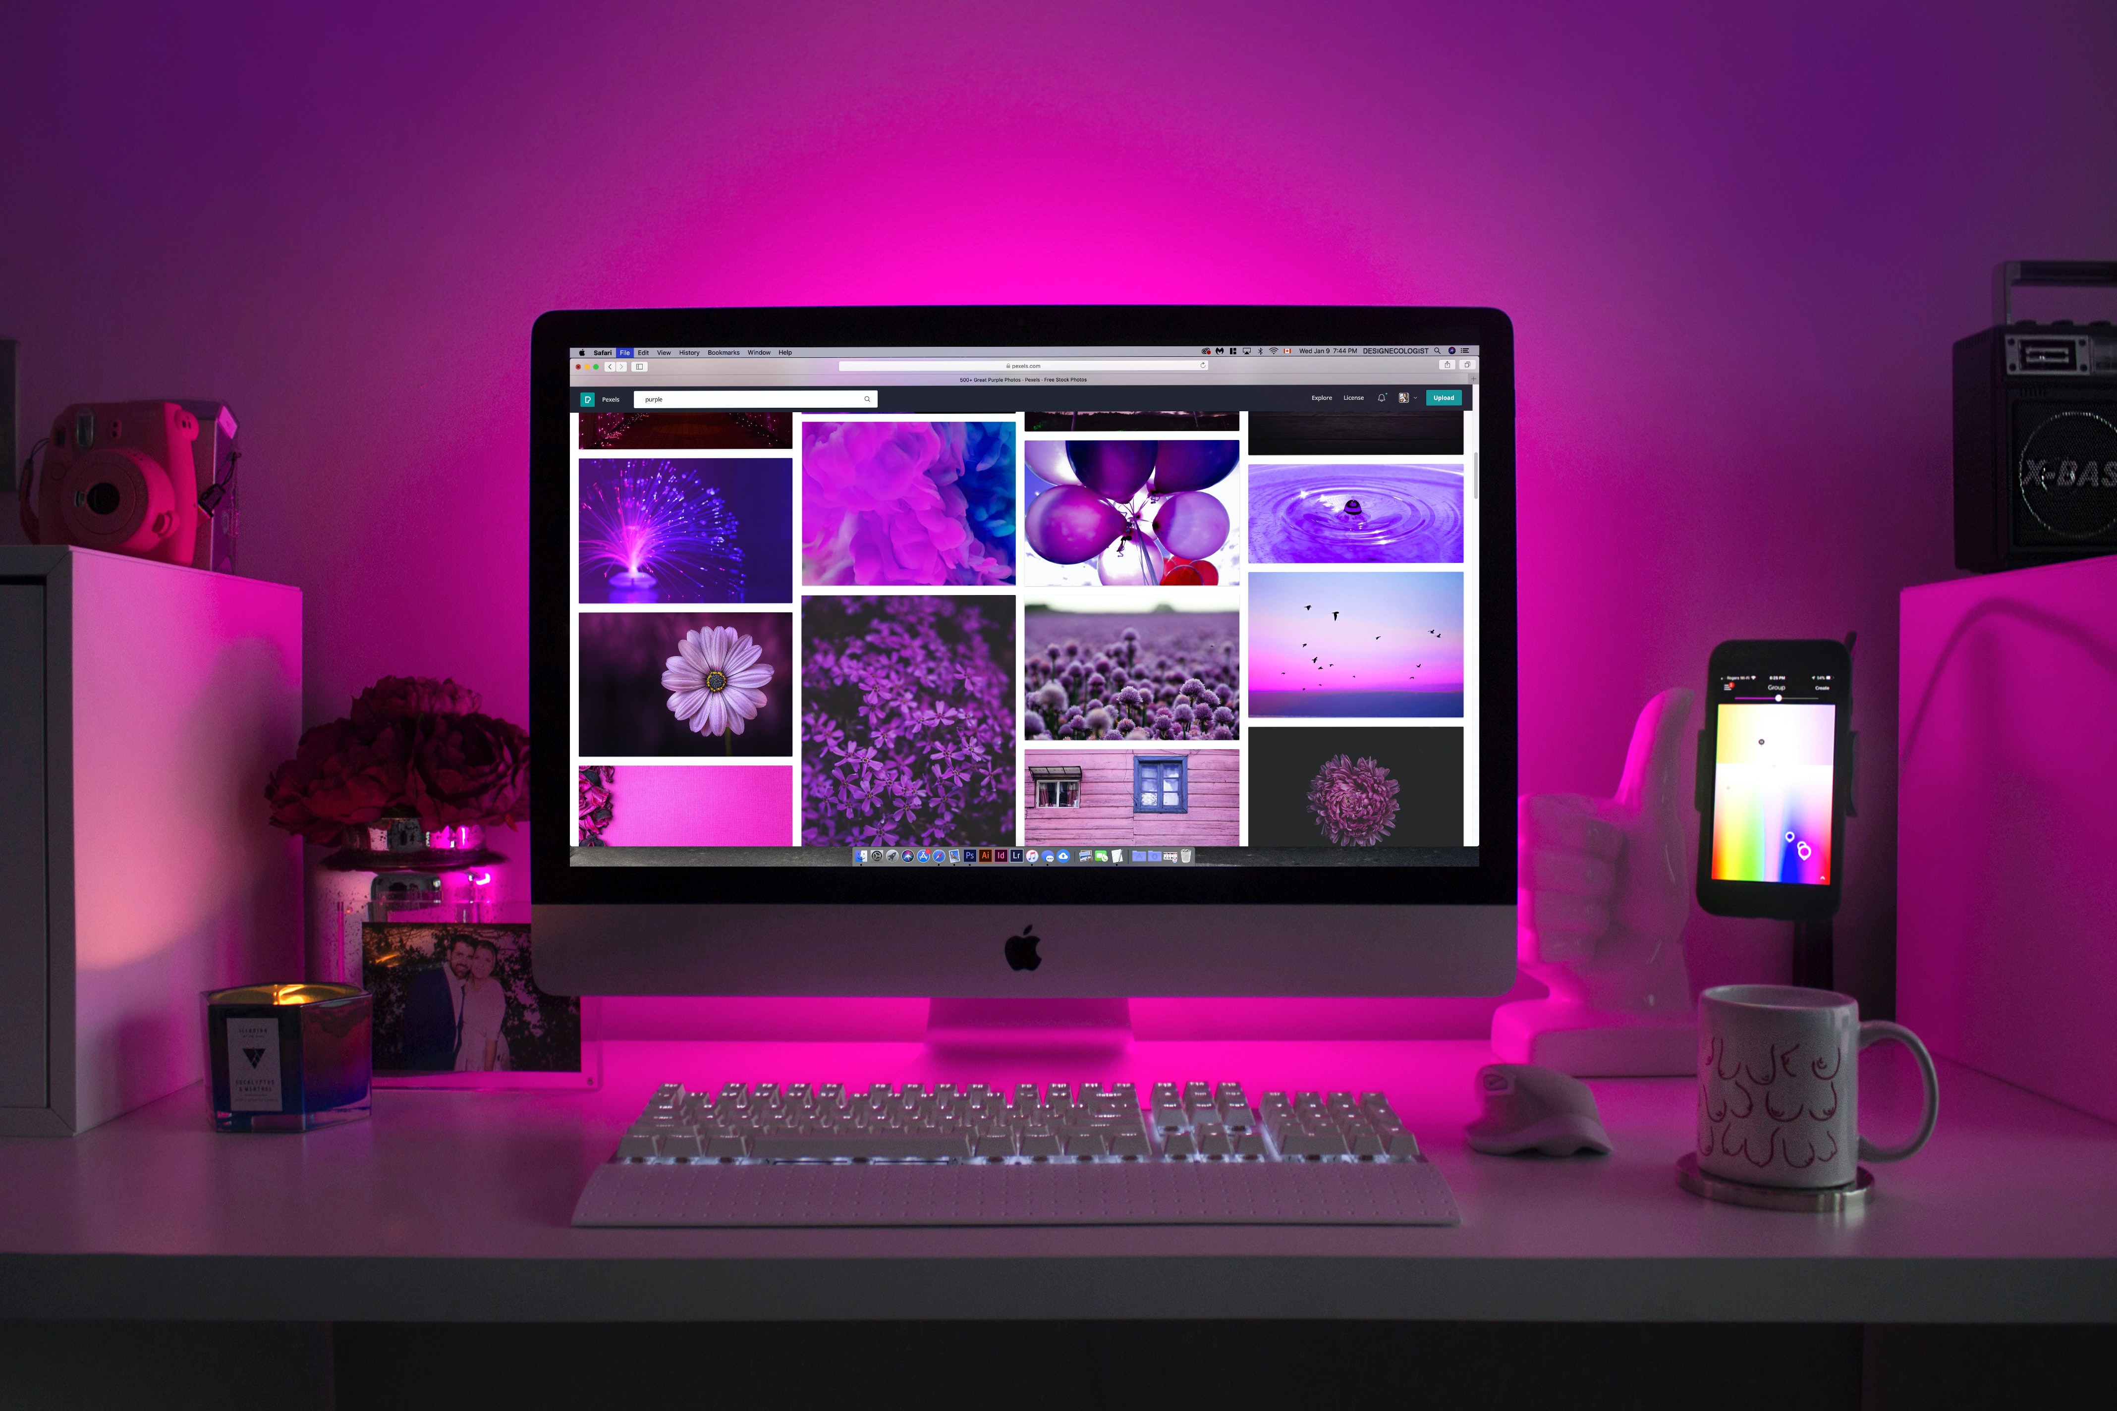
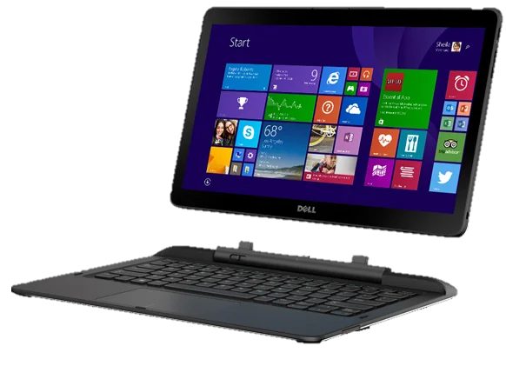
TYPES OF COMPUTER
ANALOG
HYBRID
DIGITAL
6
Based on Mechanism
Source: https://www.google.com/imghp?hl=en

Slide 8
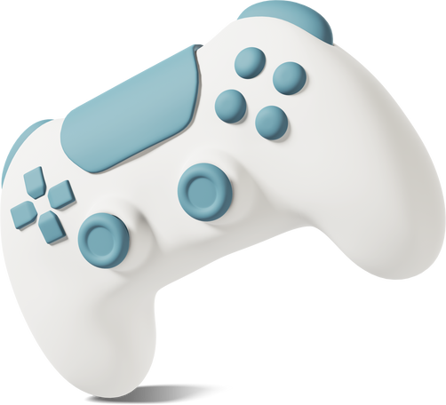



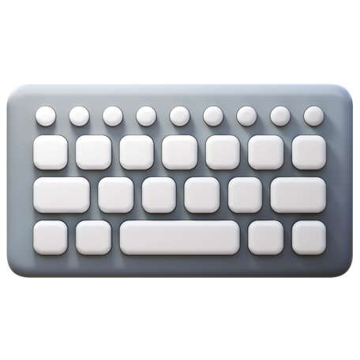

Input and Output Devices
7
Source: https://www.google.com/imghp?hl=en

Slide 9




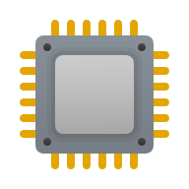
HARDWARE
RAM
PROCESSOR
MOTHERBOARD
GPU
HDD AND SSD
8
Source: https://www.google.com/imghp?hl=en

Slide 10
Software
MD Parvez Hossain, Team Ninja
9

Slide 11




What’s Software?
Adobe
VSCode
Office
Autocad
10
Source: https://icons8.com/

Slide 12

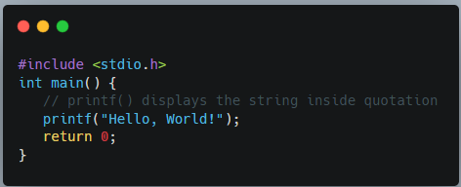

Creating a simple program
Source Code
Compiling
Exe File
11
Source: https://icons8.com/

Slide 13




Malware and Anti-malware
Different type of malicious software.
viruses
Ransomware
Anti-malware
Spyware
12
Source: https://icons8.com/

Slide 14
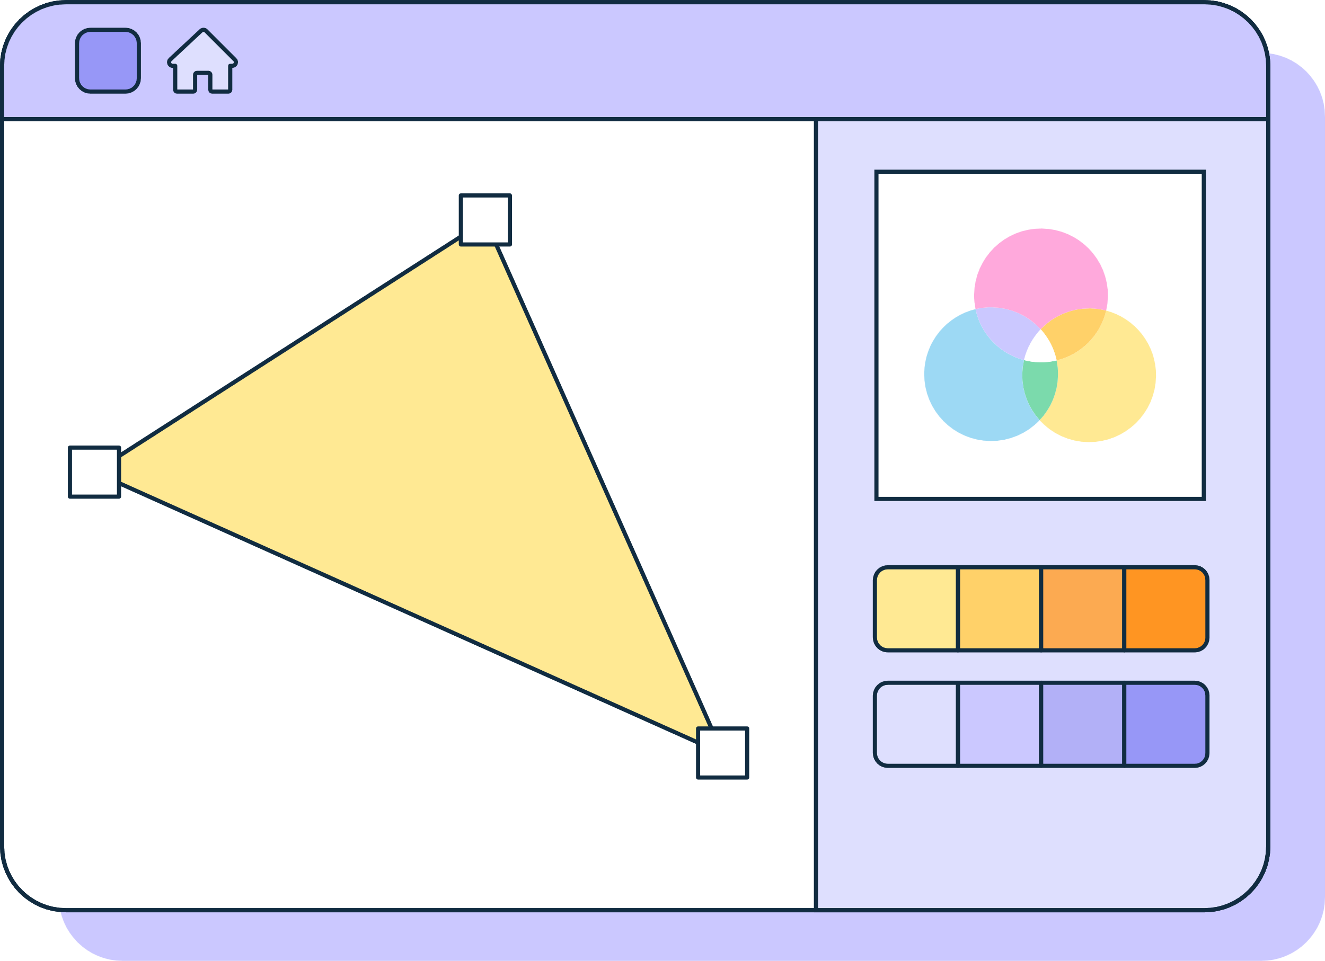

GUI and CLI
Ease of use
Memory Consummation
Performance
GUI
CLI
13
Source: https://icons8.com/

Slide 15
Cloud Computing
Arpita Islam Orpa, Team Ninja
14

Slide 16




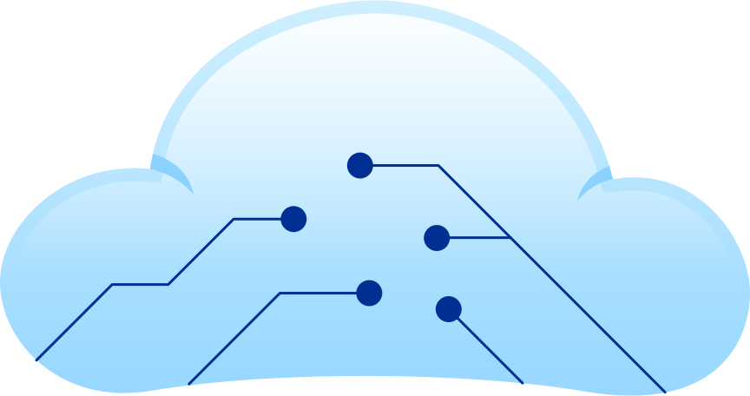
Cloud Computing
15
Source: https://icons8.com/

Slide 17
Why cloud computing
is necessary?
Reliability
Scalability
Sustainability
16
Source: https://icons8.com/

Slide 18

Cloud Service
Models
SaaS
IaaS
PaaS
17
Source: https://icons8.com/

Slide 19


Advantages:
Low-cost ownership
Off site data storage
Instant Software Update
Disadvantages:
Requires a constant internet connection
18

Slide 20
Quantum Computing
Fahad Ahmed Patwary, Team Ninja
19

Slide 21
Let’s Play a Game
20
Probability of winning
H
H
T
OR
C. Com: 50%
Player: 50%
Classical Computer
C. Computer
Player
?
H
T
OR
Quantum Computer: 97%
Quantum Computer
Q. Computer
Player
Data Courtesy: TED

Slide 22
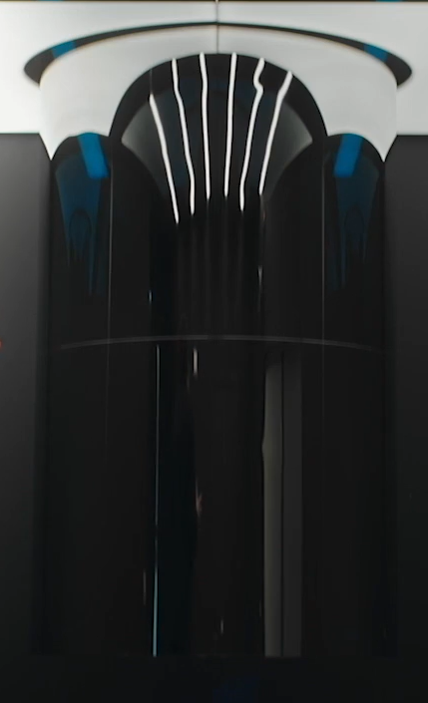
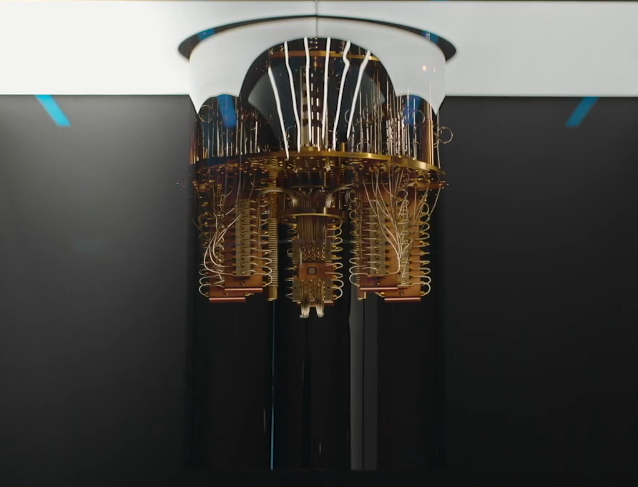
Quantum Computer
21
Source: https://www.ibm.com/

Slide 23
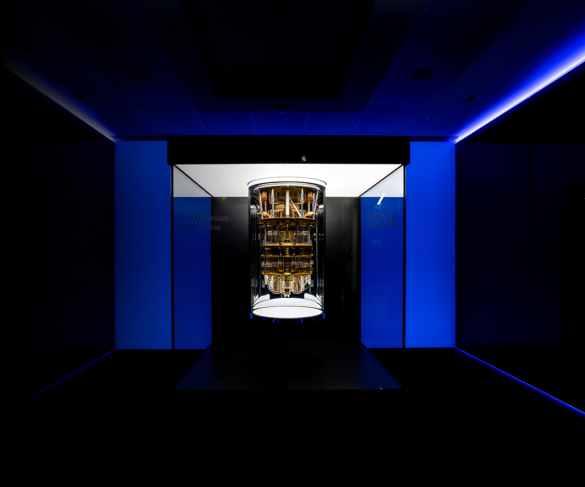
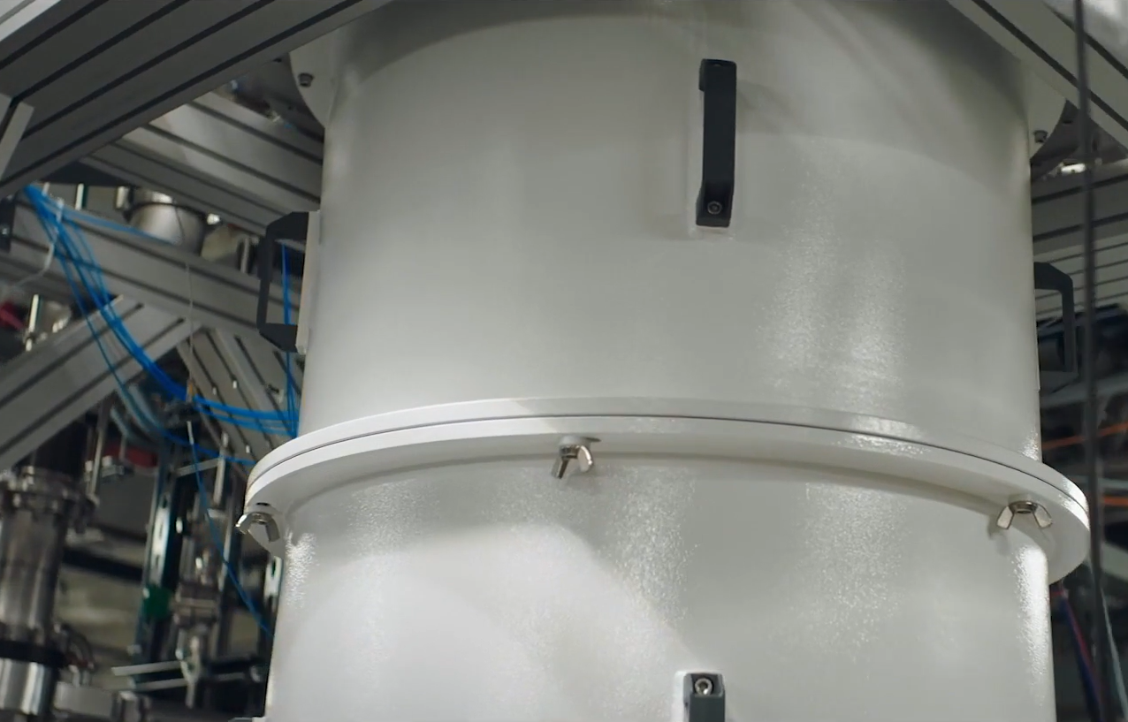
Dilution Refrigeration system
IBM Q System One
22
Source: https://www.ibm.com/

Slide 24
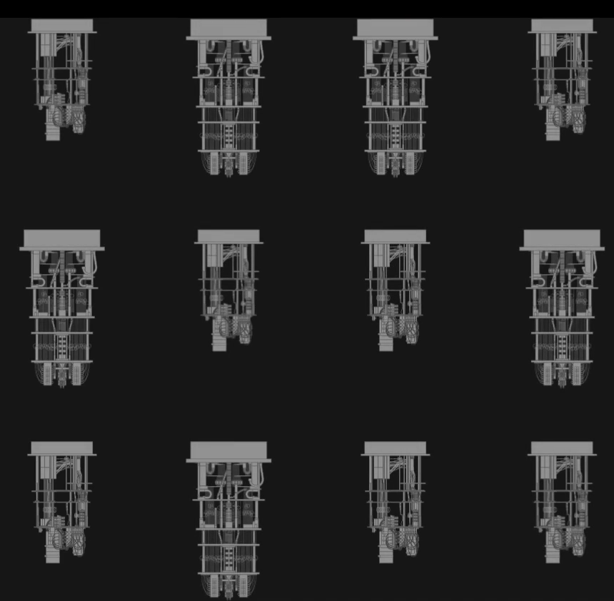
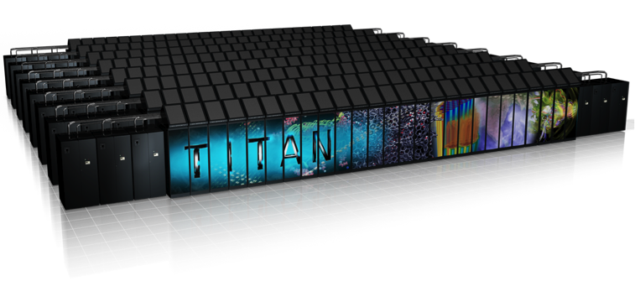
Why do we need quantum computers?
Supercomputer
23
Source: https://www.ibm.com/

Slide 25
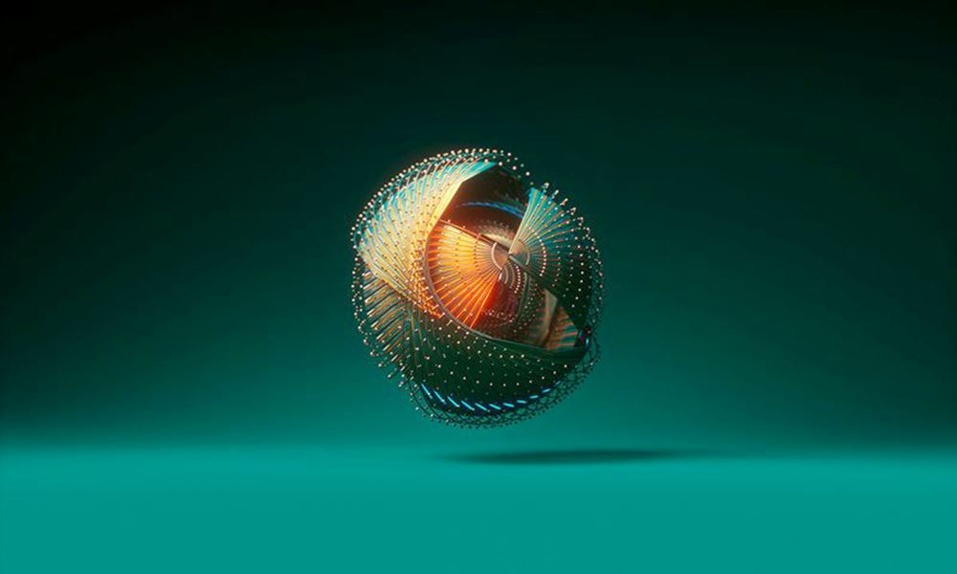
Quantum Operating System
Deltaflow.OS
24
Source: https://www.riverlane.com/

Slide 26



Where are quantum computers used?
Mercedes
ExxonMobil
CERN
ExxonMobil uses quantum computers to ship cleaner fuels.
Mercedes-Benz is using quantum computers to design better batteries.
The quest to understand what sews the universe together.
25
Source: https://www.ibm.com/

Slide 27
Uses of Computer Technology
Shihab Uddin Ahmed, Team Ninja
26

Slide 28

Patient
Monitoring
Medical Equipment
Communication
And
Telemedicine
Research
Medical and Health
27
Source: https://icons8.com/

Slide 29


Education
Defence
28
Source: https://icons8.com/

Slide 30


Computer in our daily life
29
Source: https://icons8.com/

Slide 31
Internet of Things
Foisal Arefin, Team Ninja
30

Slide 32
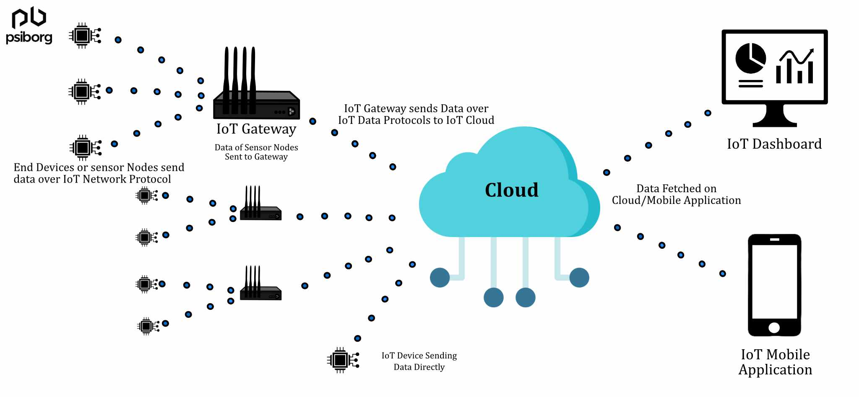
31
Source: https://psiborg.com/

Slide 33

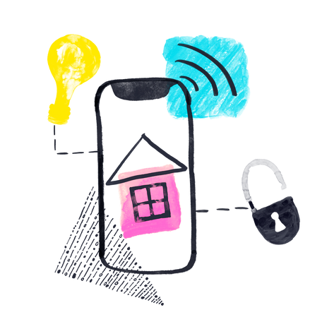
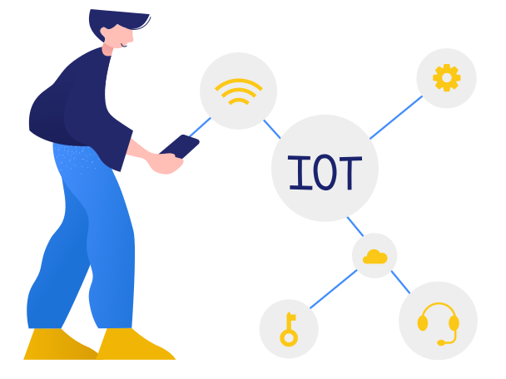
Sensors
Connectivity
Data Processing
32
Source: https://icons8.com/

Slide 34
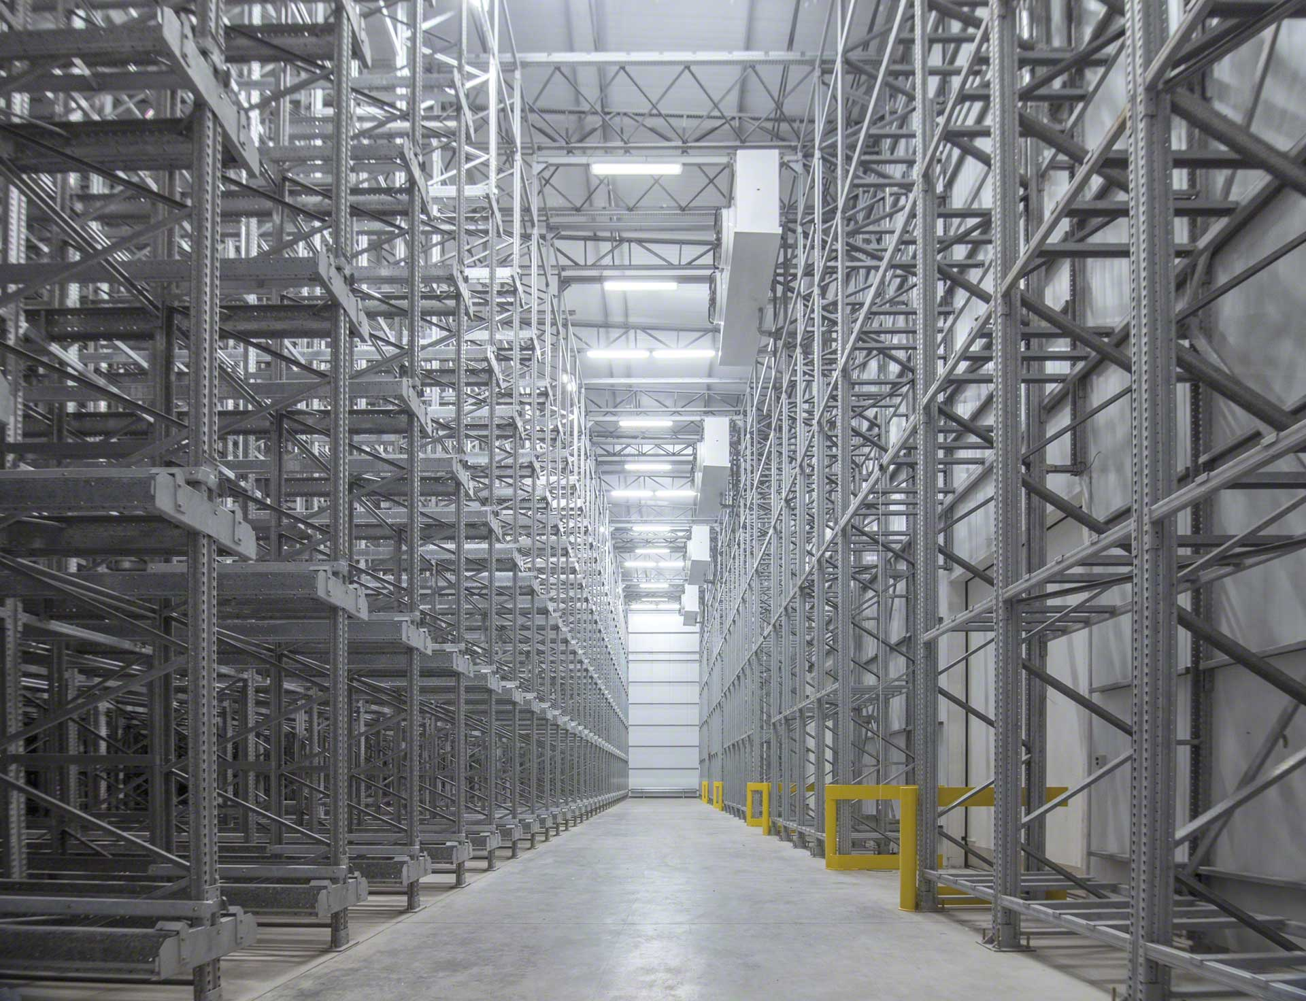
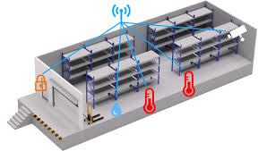
Cold Storage Management
33
Source: https://google.com/images

Slide 35

Question & Answer

